Slide 1

XPath in Selenium Web Driver

Slide 2
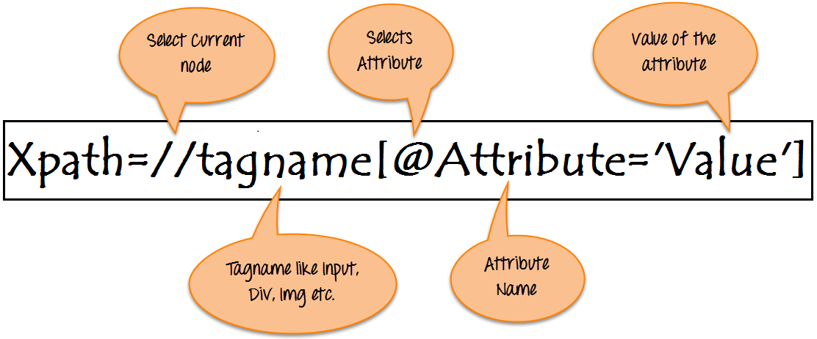
Introduction
XPath is defined as XML path.
It is a syntax or language for finding any element on the web page using XML path expression.
XPath is used to find the location of any element on a webpage using HTML DOM structure.
// : Select current node.
Tagname: Tagname of the particular node.
@: Select attribute.
Attribute: Attribute name of the node.
Value: Value of the attribute.

Slide 3
Xpath Locators
XPath Locators | Find different elements on web page
ID | To find the element by ID of the element
Classname | To find the element by Classname of the element
Name | To find the element by name of the element
Link text | To find the element by text of the link
XPath | XPath required for finding the dynamic element and traverse between various elements of the web page
CSS path | CSS path also locates elements having no name, class or ID.

Slide 4
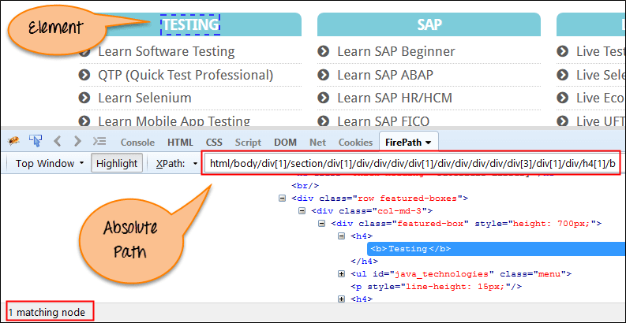
Types of X-path
Absolute XPath :-
It uses Complete path from the Root Element to the desire element, but the drawback of the absolute XPath is that if there are any changes made in the path of the element then that XPath gets failed.
The key characteristic of XPath is that it begins with the single forward slash(/).
Example:-
html/body/div[1]/section/div[1]/div/div/div/div[1]/div/div/div/div/div[3]/div[1]/div/h4[1]/b

Slide 5
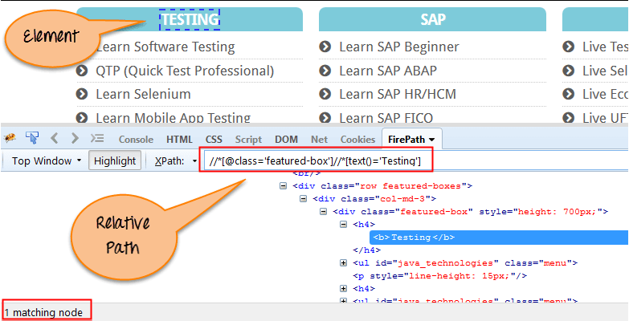
2) Relative XPath:-
It can simply start by referencing the desire element and go from there.
The key characteristic of XPath is that it begins with the Double forward slash.
Example:-
Relative xpath: //*[@class='featured-box']//*[text()='Testing']

Slide 6
Difference between single ‘/’ or double ‘//’
A single slash at the start of Xpath instructs XPath engine to look for element starting from root node which means to look for the element immediately inside its parent element.
A double slash at the start of Xpath instructs XPath engine to search look for matching element anywhere in the XML document which means to look for any child or any grand-child element inside the parent element.

Slide 7
XPath axes
XPath axes search different nodes in XML document from current context node.
XPath axes methods are used to find those elements, which dynamically change on refresh or any other operations.
XPath axes methods are:-
Ancestor
Child
Preceding
Following-sibling
Parent
Self
Descendant

Slide 8
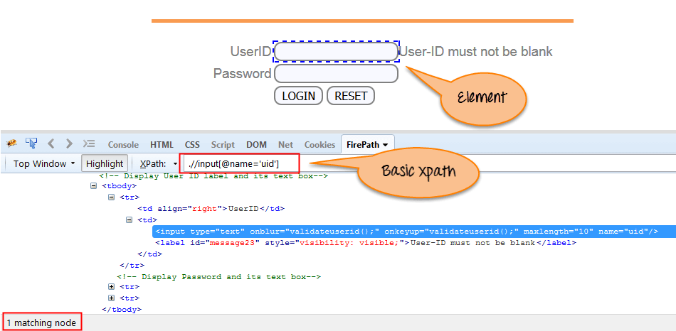
Using Xpath in Selenium
Basic XPath:-XPath expression select nodes or list of nodes on the basis of attributes like ID , Name, Classname etc.
Example:-
Xpath=//input[@name='uid']

Slide 9
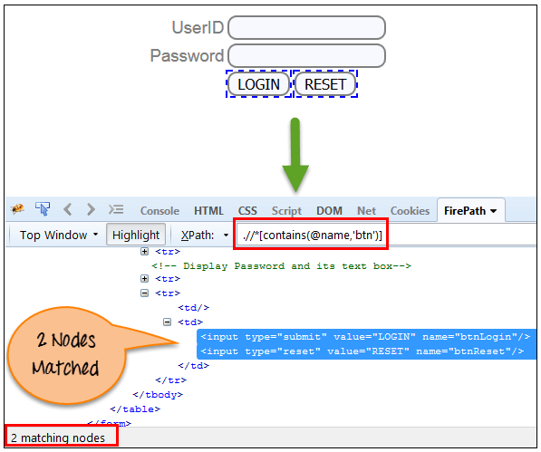
2) Contains() :- It is used when the value of any attribute changes dynamically.
Example:-
Xpath=.//*[contains(@name,'btn')]

Slide 10
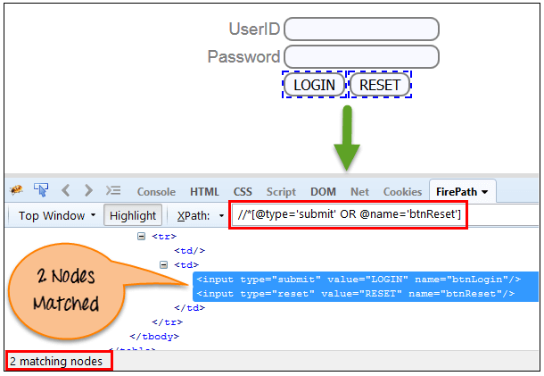
3) Using OR & AND:-
In OR expression, two conditions are used, any one condition should be true to find the element.
Example:-
Xpath=//*[@type='submit' OR @name='btnReset']

Slide 11
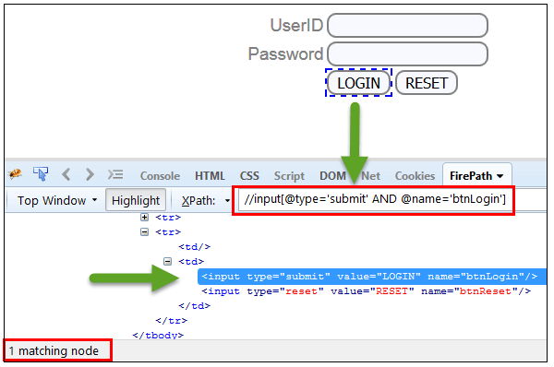
In AND expression, two conditions are used, both conditions should be true to find the element. It fails to find element if any one condition is false.
Example:-
Xpath=//input[@type='submit' AND @name='btnLogin']

Slide 12
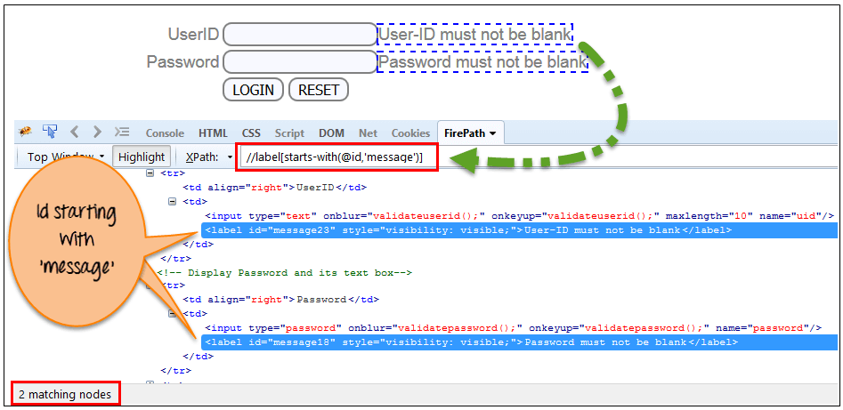
4) Start-with function:-Start-with function finds the element whose attribute value changes on refresh or any operation on the webpage.
Example:-
Xpath=//label[starts-with(@id,'message')]

Slide 13
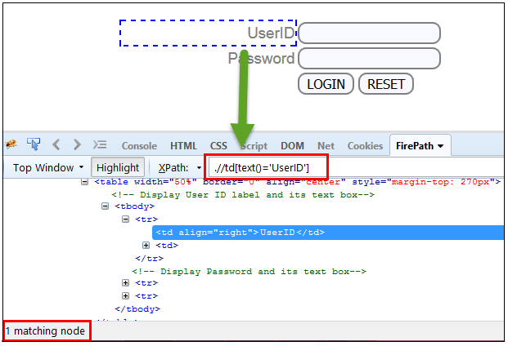
5) Text():-Text function finds the element with exact text match.
Example:-
Xpath=//td[text()='UserID']

Slide 14
Covered Till Now
XPath is required to find an element on the web page as to do an operation on that particular element.
There are two types of XPath:
Absolute XPath
Relative Xpath
XPath expression select nodes or list of nodes on the basis of attributes like ID , Name, Classname, etc. from the XML document .

Slide 15
Thanks

